Slide 1
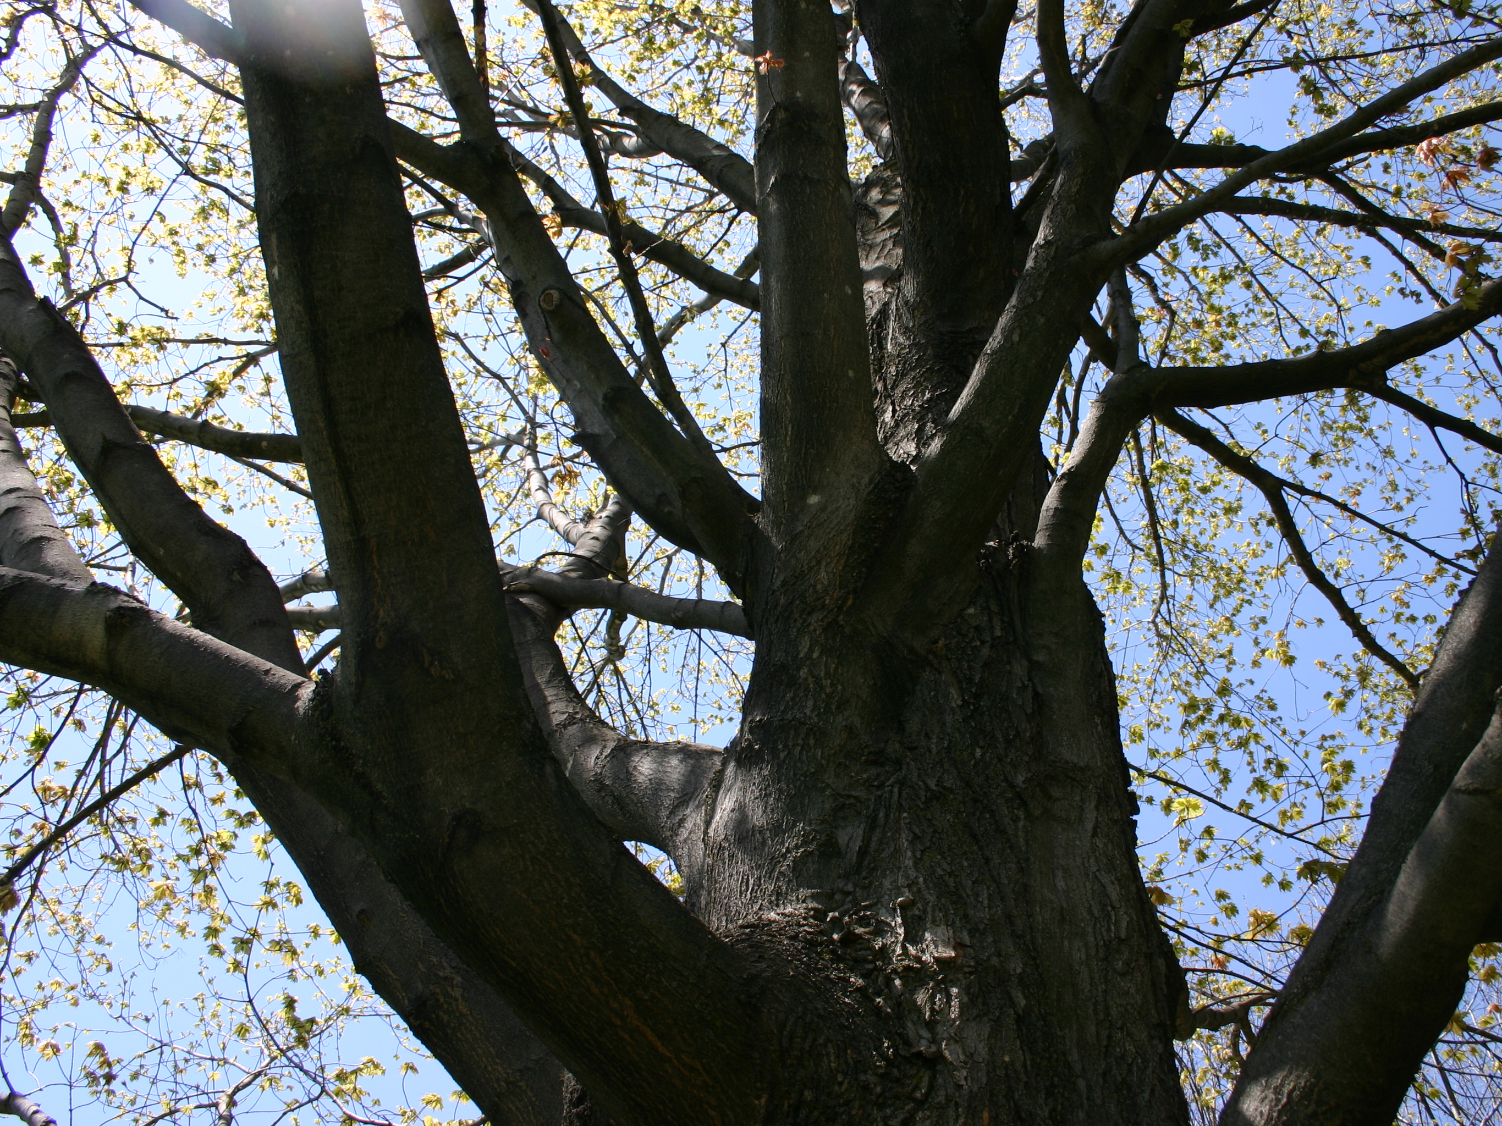

Key Findings and Recommendations from an i-Tree Eco inventory in the City of Winooski:
Phase 2
Prepared for the Winooski Natural Resources Conservation District by
Alexandra Kosiba
Updated November 2015 by Laura Dlugolecki

Slide 2




Urban Canopy Inventory in Winooski
  In 2014 and 2015, The Winooski Natural Resources Conservation District (WNRCD) received a Caring for Canopy grant from the Vermont Department of Forest Parks and Recreation to complete an ecosystem service inventory of the urban tree canopy in the City of Winooski and to increase the capacity for tree management in Winooski.
  WNRCD worked with multiple partners to complete this inventory, including: The Vermont Monitoring Cooperative, Winooski Department of Public Works and student volunteers from the Rubenstein School of Environment and Natural Resources at the University of Vermont.

Slide 3
Why Complete a Canopy Inventory in Winooski?
As the most densely populated city in Vermont, Winooski’s urban canopy has an extremely important role both socially and environmentally.
An inventory of the urban canopy will help the City of Winooski and its residents understand the makeup and function of the urban forest they already have.
The collected and analyzed data will strengthen current City efforts to develop a community-driven tree program that maximizes ecosystem services provided by trees, including carbon storage and stormwater runoff absorption.

Slide 4
Summary of i-Tree inventory process conducted by UVM volunteers
Data collected from a total of 62 field plots (.5 hectare) in Winooski (39 plots in 2014, 23 plots in 2015).
  stratified by land use type: residential, commercial-industrial, or public
Collected data on
  ground and tree cover
  available planting space
  individual tree and shrub attributes – such as, species, stem diameter, height, crown width, dieback, and proximity to residential buildings
Analyzed using i-Tree Eco model (U.S. Forest Service)
  estimates trees per species and land use type, plot characteristics, and ecosystem services provided by the woody vegetation

Slide 5
Inventory Goals
Quantify the carbon sequestration and rainfall infiltration (avoided runoff) by the urban forest in Winooski
    Values of ecosystem services are quantified using national ecosystem service values
      Social cost of carbon – default value and current value (2014)
        $78.50 → $156.60/metric ton CO₂
      Cost of stormwater treatment: national value
        $0.0089 per gallon
Use these results to communicate the value of the urban canopy in Winooski, recommend future plantings to maximize these two ecosystem services, inform citizen-run Tree Board

Slide 6
Key Findings & Valuation Estimates
Estimated number of urban trees: 56,400
Tree cover: 35.8%
Most common species: Boxelder, Red maple, American elm
Percentage of trees less than 6"diameter: 54.6%
Estimated pollution removal: 12 metric tons/yr ($394,000/yr)
Estimated carbon storage: 11,700 metric tons ($919,000-1,832,200)
Estimated carbon sequestration: 387 metric tons/yr ($30,400/yr-$60,600/yr)
Estimated oxygen production: 855 metric tons/yr
Estimated avoided runoff: 29,100 cubic meters/yr (1,028,000 ft³/yr) ($68,400/yr)
Estimated structural value: $62 million-$62.9 million
Estimated functional value: $492,800-$523,000

Slide 7
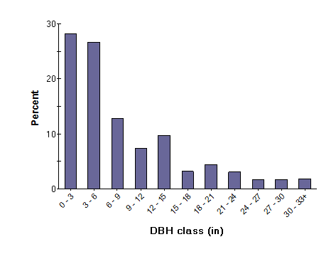
Percent of tree population by diameter class
54.6% are less than 6” in diameter
Winooski has a relatively young forest.
Percent in class
DBH Class (inches)
DBH= Diameter at Breast Height (1.4m)
From: i-Tree Eco Report

Slide 8
Percent of trees by assessed crown condition city wide
77% of trees are in excellent or good condition.

Slide 9
Percent of trees by assessed crown condition by land use type
Land use affects tree health

Slide 10
Estimated tree density
Trees cover approximately 35.8% of the city of Winooski.

Slide 11
Estimated rainfall intercepted by woody vegetation
This equates to 19,3184 gallons for commercial-industrial land, 4,648,024 gallons for public land, and 2,845,179 gallons for residential land. Trees intercept approximately 7,689,974 gallons a year. It would cost $68,409 to treat that water annually.

Slide 12
Estimated percent of space available for planting

Slide 13
Estimated percent of groundcover per land use type
Limitations on planting space exist due to ground cover and landuse

Slide 14
Relative Tree Effects
Total carbon storage is equivalent to… | Amount of carbon emitted in Winooski in 107 days Annual emissions from 7,750 automobiles Annual emissions from 3,890 single-family houses
Annual carbon sequestration is equivalent to… | Amount of carbon emitted in Winooski in 3.5 days Annual emissions from 300 automobiles Annual emissions from 100 single-family houses
Carbon monoxide removal is equivalent to… | Annual emissions from 1 automobile Annual emissions from 3 single-family houses
Nitrogen dioxide removal is equivalent to… | Annual emissions from 85 automobiles Annual emissions from 57 single-family houses
Sulfur dioxide removal is equivalent to… | Annual emissions from 267 automobiles Annual emissions from 4 single-family houses
Particulate matter less than 10 micron (PM₁₀) removal is equivalent to… | Annual emissions from 13,000 automobiles Annual emissions from 1,250 single-family houses

Slide 15
Recommendations
Task | Outcome
Increase the number of sampled plots for i-Tree Eco | Decreases standard error (uncertainty) around estimates
Increase the total number of trees in Winooski | Increase both total carbon storage and annual sequestration Increase the total leaf cover and rainfall infiltration Increase pollution abatement
Increase the number of large trees | Increase total carbon storage Increase the total leaf cover and rainfall infiltration Increase pollution abatement
Maintain good health of the city’s current trees | Maintain total carbon storage and annual sequestration Maintain tree’s full leaf canopy and rainfall infiltration Maintain pollution abatement Long-term investment

Slide 16
Recommendations
Task | Outcome
Promote long-lived tree species | Increase long-term carbon storage Avoid replanting costs Reduces pollutant emissions from planting and removal
Increase the structural diversity of planted areas e.g., maintaining woody shrubs and small trees below large trees | Increase both total carbon storage and annual sequestration Increase the total leaf cover and rainfall infiltration Increase pollution abatement
Promote trees with high leaf area indexes e.g., larger trees, certain species | Increase rainfall infiltration Increase pollution abatement
Utilize evergreen trees | Increase removal of particulate matter for more months of year Increase rainfall infiltration for more months of year

Slide 17
Recommendations
Task | Outcome
Utilize low maintenance trees | Reduce pollutants emissions from maintenance activities Reduces maintenance costs
Increase tree cover in commercial-industrial lands Commercial-industrial lands contain a high percentage of impervious surface and have the lowest number of trees/shrubs | Increase both total carbon storage and annual carbon sequestration Decrease runoff Increase pollution removal – esp. if proximal to parking lots/buildings
Promote a diversity of species | Help mitigate detrimental effects of introduced pest/pathogens Provides structural and genetic diversity Provides resiliency to effects of climate change

Slide 18
Summary
An increase in Winooski’s urban forest will increase the benefits of the ecosystem services the trees provide
Carbon sequestration and storage, avoided runoff, and pollution abatement, and structure values of the urban forest are not inconsequential. These services carry a high monetary valuation, with a total valuation of $62,511,800- $63,455,200 depending on the cost of carbon
The analysis suggests increasing the number, size, and variety of trees in Winooski, especially focusing on commercial-industrial areas where tree and shrub density is low, to increase ecosystem service values.
About 77% of Winooski’s trees are classified at excellent or good health
However, over half the trees are small in diameter, it is important to maintain these trees to maximize the benefits from the urban forest

Slide 19
Additional Project Components and Next Steps
Volunteers worked with the Winooski Natural Resources Conservation District and the Winooski Department of Public Works to plant 130 trees at the Wastewater Treatment Facility on West Allen St. These trees were planted to reduce stormwater runoff and to replace tree loss
Winooski’s Tree Management Plan will be updated. Important baseline data will be supplied by this inventory

Slide 20
Additional Project Components and Next Steps
The Winooski NRCD will work with the City of Winooski to develop a citizen-run Tree-Board to oversee tree health and management in the City.
WNRCD has funding to plant two street trees in spring 2016.
WNRCD will work with Winooski to meet ‘Tree City USA’ guidelines.

